Slide 1
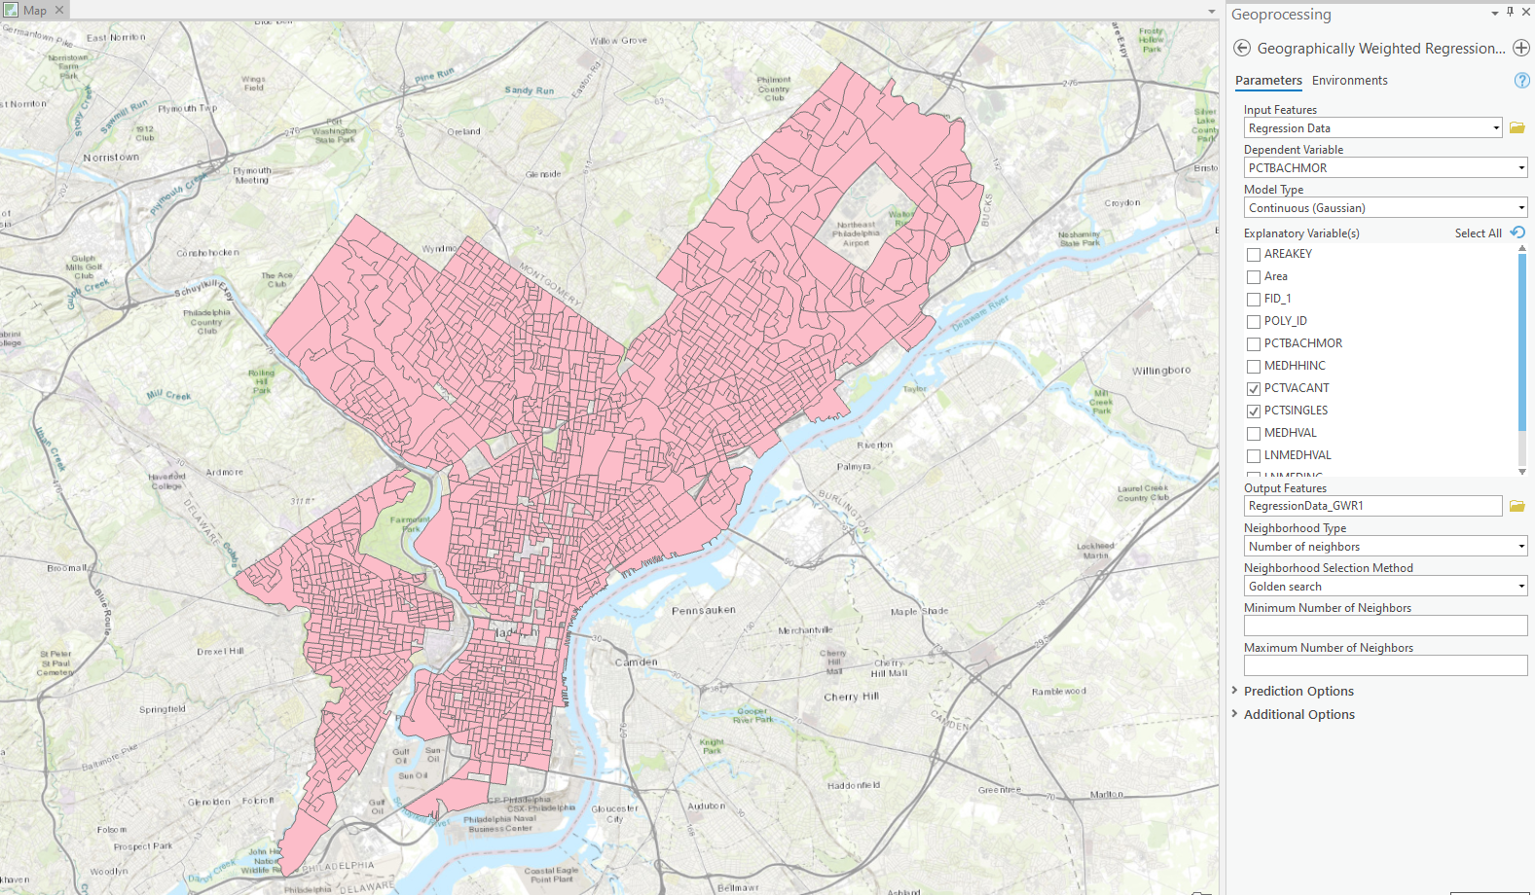
Running GWR in ArcGIS Pro with the settings to the right…

Slide 2
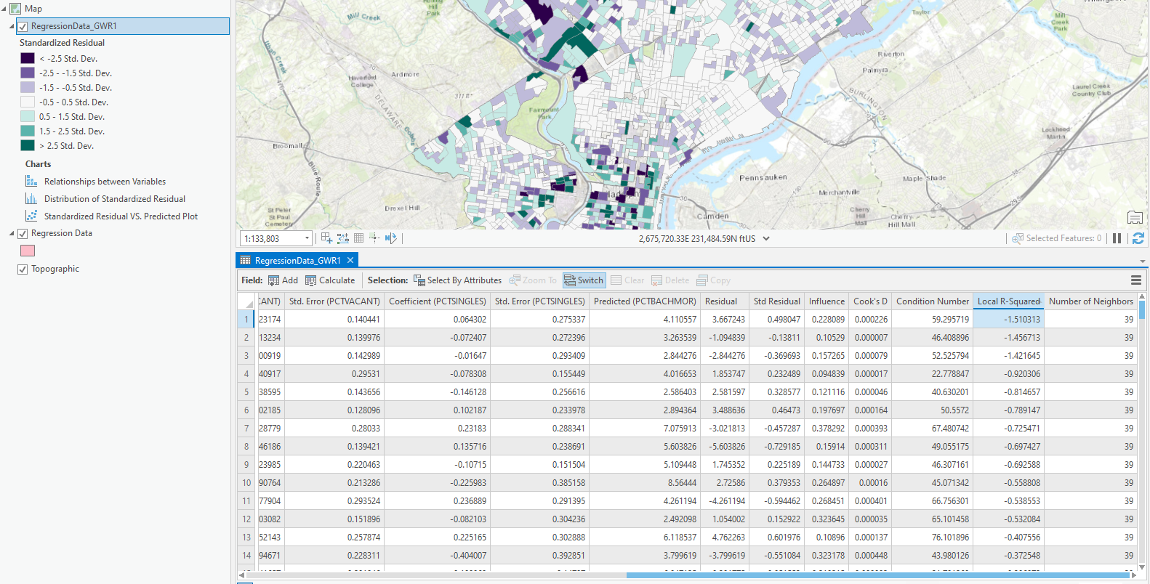
Looking at the attribute table of the output shapefile. When Local R-Squares are sorted in ascending order, some Local R-Squares are negative, and the multicollinearity condition number seems to be unreasonably high.

Slide 3
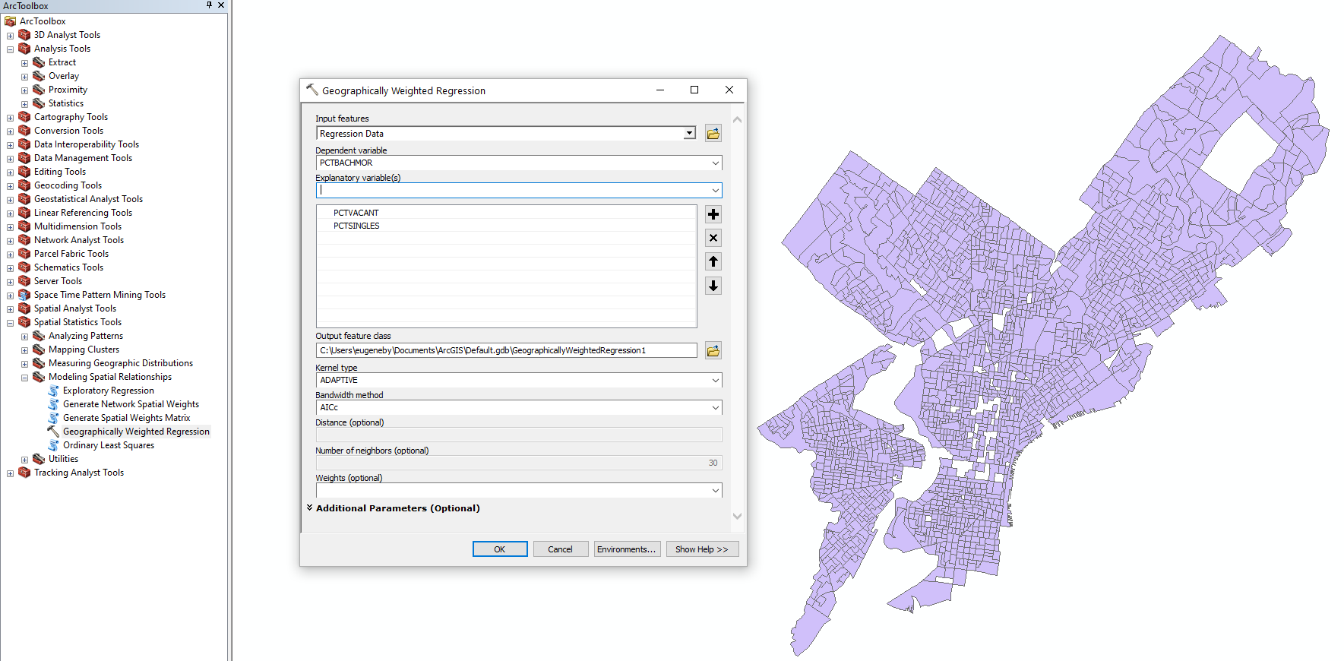
Running GWR in ArcMap – same data set, same dependent and independent variables

Slide 4
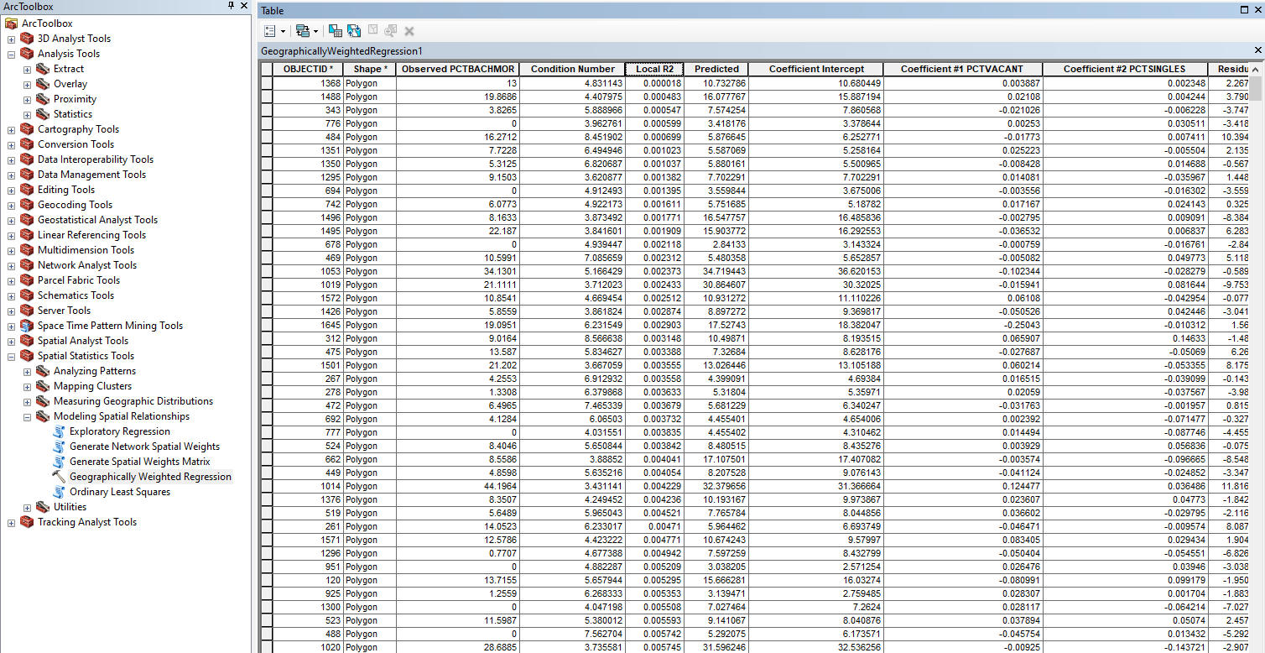
Here, the lowest local R square is 0.000018 – positive.

